Slide 1

Contradictions of Capitalism
Tutorial Presentation:
Kabir Kumar
Rohith P
Nirbhay Kumar

Slide 2
Contents
The Tendency of the Rate of Profit to Fall
Reserve army of labour
Boom and Bust cycles
Class Antagonisms
Crisis of Overproduction
Automation
To begin with, we define basic terms and aspects.

Slide 3
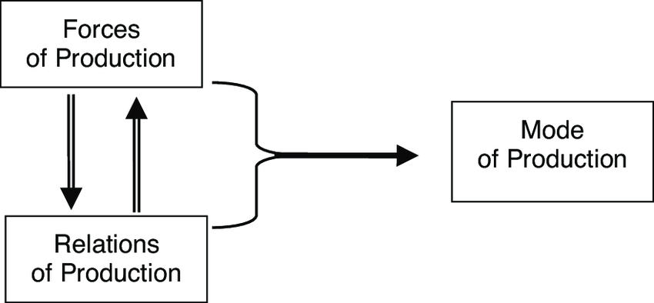
Modes of Production
Modes of production are the ways in which society is organized to produce goods and services. It refers to the ways in which the costs and benefits of economic activities are allotted.
It includes the “forces of production” and the “relations of production”.
The forces of production include human labour and the means of production(machinery, infrastructure, land, etc.)
The relations of production refer to the social relationships arising in the process of production, mainly between owners and non-owners of means of production.

Slide 4
The Capitalist Mode of Production
It is characterized by the private ownership of the means of production.
Under the capitalist system, the basis of production relations is the capitalist ownership of the means of production which is used for exploiting wageworkers.
“the capitalist mode of production rests on the fact that the material conditions of production are in the hands of non-workers in the form of property in capital and land, while the masses are only owners of the personal conditions of production, of labour-power". (Marx, "Critique of the Gotha Programme", Marx and Engels, Selected Works, 1950, English edition, vol. II, p. 23.)
It relies on the extraction of surplus value of the worker to create profits.
Wage labour and market based economies are another defining aspect.

Slide 5
Constant Capital, Variable Capital, LToV
Constant Capital is the sum total of the value of means of production; the factories, machines, raw materials, fuel, and other necessary products and material inputs used in the production process.
Variable Capital is the value of human labour purchased by the capitalists and employed by them in the production process.
Variable Capital is different from Constant or Dead Capital in the sense that it can create value.
According to Marx’s Labour Theory of Value, the “value” of any commodity is defined as the “the amount of socially necessary labour embodied in a particular commodity”.
Price is merely the exchange value of a commodity estimated in money.
Socially necessary labour time is the amount of labour time performed by a worker of average skill, working on tools of average productive potential, to produce a given commodity.

Slide 6
Surplus Value
Surplus Value is the value produced by workers in the capitalist system of production which is over and above that which goes to pay their wages, and the costs of raw materials, and other expenses required to keep the production process going. It is the prime source of profit for the capitalist, who appropriates this from the worker.
Marx describes how and why surplus value is formed in “Wage Labour and Capital”.
Marx states that the wage worker sells not his labour, but his labour power to the capitalist, for a stipulated amount of time for an agreed upon wage. To derive a profit, the capitalist has to pay the worker less than what they are capable to produce; profit needs incomplete compensation for the labour provided by the worker.
The worker hence, has two aspects to his labour. The first part being the necessary labour, to compensate their wages; and the second, is the surplus labour.

Slide 7
Surplus Value
The surplus labour provided by the worker, hence creates surplus value, which is what translates into a profit for the capitalist. In short then, surplus value is the difference in value at which a commodity is exchanged by the capitalist, and the cost it took to make that commodity.
Profit hence, is impossible without surplus labour and surplus value, it is necessary to sustain the capitalist mode of production. This in turn means that the worker will always receive lesser in monetary compensation than what he has produced.
“…the object of production is surplus-value, and a laborer is not regarded as performing productive work unless he produces surplus-value for the capitalist, or unless his labor causes capital to expand.”
Deville, The People’s Marx(1893)
Surplus value can be classified as absolute and relative.

Slide 8
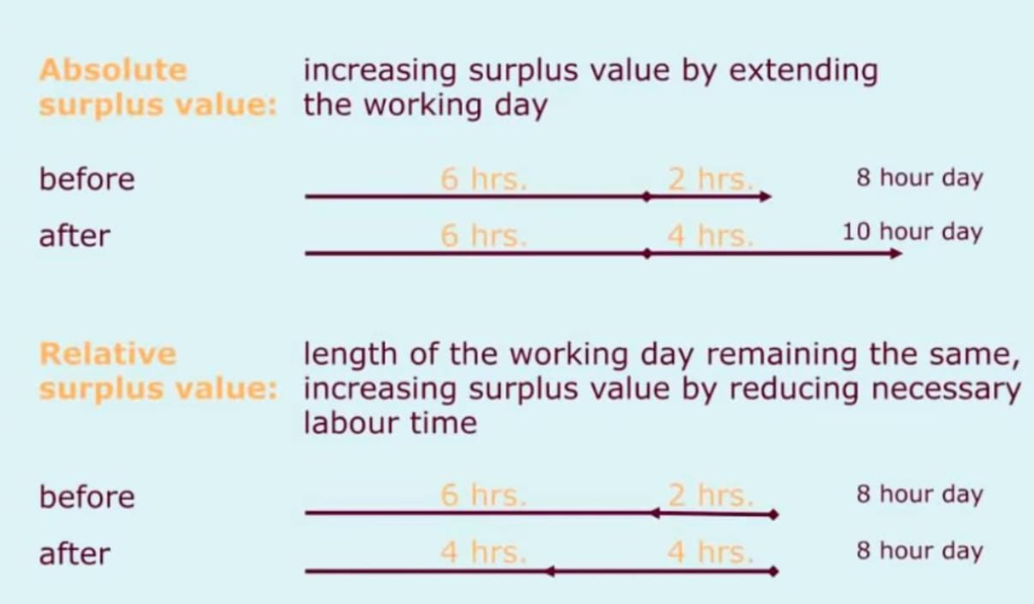
Absolute and Relative Surplus

Slide 9
The Tendency of Rate of Profit to Fall
Rate of Profit is the ratio of surplus value to the capital invested.
The drive for larger profits pushes the capitalist to adopt methods that reduce the necessary labour time; to increase the surplus value created. This is because increasing absolute surplus can only be achieved through the extension of work hours, but there will always be a definite upper limit to how much a person can work. Moreover the working class might get radical and fight for shorter work days etc.
Reducing necessary labour time is realized by the capitalist by their attempts to innovate faster methods of production, and to reduce the production prices.
The reduction in the cost of production is achieved through labour saving technical progress; the labour inputs are increasingly substituted by non labour inputs, like advanced machinery and automation.
While this leads to an increase in productivity and decrease in production cost, it reduces the amount of workers, who are the fundamental source of surplus value in production.

Slide 10

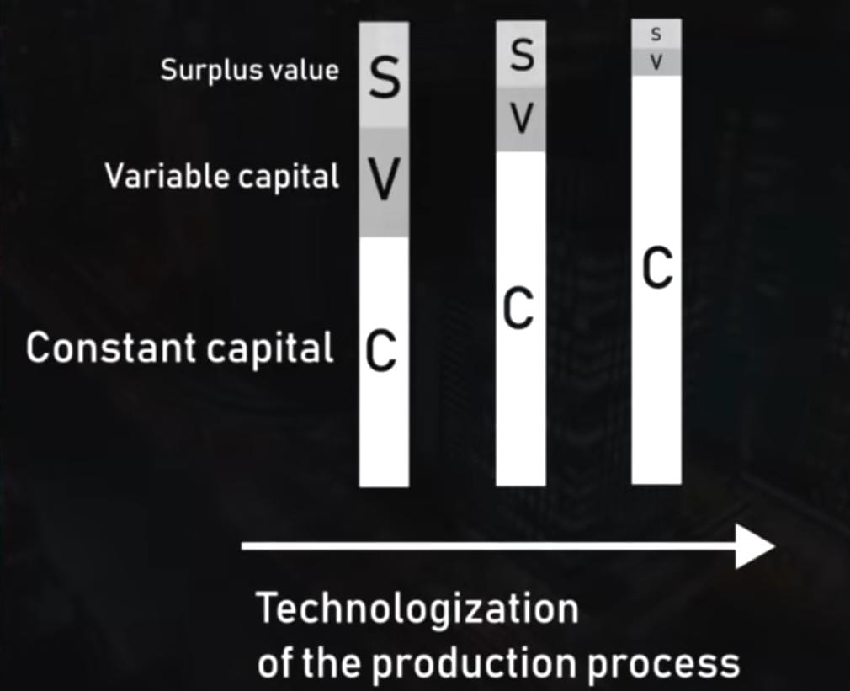
The Tendency of Rate of Profit to Fall
The increasing replacement of labour with non labour inputs is reflected in a rise of the share of total capital outlays supporting constant capital in relation to variable capital.
In Marx’s terms, this ultimately causes a fall in the composition of capital – reduction in the amount of labour available for exploitation.
This causes a tendency in the rate of profit to fall.
This inbuilt tendency of the capitalist to reduce the rate of profit which is the very core of capitalism poses itself as one of the fundamental contradictions to it.

Slide 11
The Tendency of Rate of Profit to Fall
“The progressive tendency of the general rate of profit to fall is, therefore, just an expression peculiar to the capitalist mode of production of the progressive development of the social productivity of labor. … proceeding from the nature of the capitalist mode of production, it is thereby proved a logical necessity that in its development the general average rate of surplus-value must express itself in a falling general rate of profit. Since the mass of the employed living labor is continually on the decline as compared to the mass of materialized labor set in motion by it, i.e., to the productively consumed means of production, it follows that the portion of living labor, unpaid and congealed in surplus-value, must also be continually on the decrease compared to the amount of value represented by the invested total capital.”
Marx, Chapter 13, Capital Vol. III

Slide 12
Countertendencies
Marx noted the existence of powerful countertendencies to this, in capitalist economies. They dampen or reverse the tendency of rate of profit to fall. Marx mentions five countertendencies, which are
the increasing intensity of exploitation of labour, which can increase rate of surplus value,
relative cheapening of elements of constant capital,
deviation of wage rate from the value of labour-power(reduction of wages),
the existence and increase of a relative surplus population(reserve army of labour),
the cheapening of consumption and capital goods through imports.

Slide 13
Reserve Army of Labour
Engels first used the term in “The Condition of Working Class in England”(1845). Marx theorized how the reserve army of labour was a necessary part of the capitalist mode of production.
Marx argued that under capitalism, a significant chunk of the population would be employed, due to its drive for productivity. In order to facilitate the lowering of wages and the need for an ever eager work force that will always work for less, capitalism necessitates the existence of a reserve army of labour, or a large group of perpetually existing unemployed.
“If accumulation, the development of wealth on a capitalist basis, necessarily creates a surplus laboring population, the latter becomes, in its turn, the most powerful lever of accumulation—even a condition of existence of fully developed capitalist production” – Marx, Capital Vol. I

Slide 14
Boom and Bust Cycles
The domination and expansion of capitalism, increasing production at faster rates and for cheaper prices is “boom”. Where there is money, capitalists flock, and this invasion into a profitable field produced more commodities than required by the market.
This leads to many finished commodities not being sold, and without the sales necessary o recoup the investment, economic crisis’ occur. This is the “bust”, where capitalists lose investment, leading to factories being shut and workers losing their jobs, and the living standard in general plummets.
Engels talks about this in detail in his pamphlet titled, the “Principles of Communism”.

Slide 15
“Industry created in the steam engine the means by which it could increase industrial production within a short space of time infinitely. Free competition necessarily growing out of big industry soon took on a violent character as a result of the ease of production. Many capitalists took up the same industry and in a short time more was produced than was needed. The result was that the products could not be sold and a so called commercial crisis appeared. Factories were shut down, factory owners were driven to bankruptcy and the workers lost their bread. Extensive misery prevailed everywhere. After a while the surplus products were sold, the factories operated again, wages went up gradually and business was better than ever. But not for long. There were again too many products and a new crisis was at hand taking the same course as the previous one. Since the beginning of this century the industries thus continually moved back and forth between epochs of crises and epochs of prosperity. Such a crisis appears regularly every five to seven years accompanied every time by great misery for the workers and by general revolutionary excitement endangering society itself.”
Engels, “Principles of Communism”

Slide 16
Class Antagonisms
The non aligning interests of the working class and the capitalists are one of the most fundamental contradictions of capitalism. The capitalist wants the worker to work as much as possible, with the least wages. The worker, wants to be compensated as much as possible for the work they do. They strive for higher wages, shorter working hours and safer working conditions.
“We thus see that, even if we keep ourselves within the relation of capital and wage-labour, the interests of capitals and the interests of wage-labour are diametrically opposed to each other. A rapid growth of capital is synonymous with a rapid growth of profits. Profits can grow rapidly only when the price of labour – the relative wages – decrease just as rapidly.”
– Marx, “Wage Labour and Capital”.
This conflict interest leads to struggles, which lead to political instability; which the capitalist class tries to fight by undermining real democratic initiatives, by lobbying, bribery, propaganda and violent state repression.

Slide 17
Crisis of Overproduction
For Marx, capitalist crisis’ are “crisis of overproduction”, too many commodities are produced than can be profitably sold, and too much capital has been invested in industry, in the attempt to claim a share of the available profits.
This related back to capitalism’s boom and bust cycles, in prosperous times every capitalist invests as much as he can and steps up production.
This brings in a flood of commodities to the market, and crisis ensues.
“Overproduction demonstrates the necessary contradictions of a system that has the potential to produce real abundance, yet under which that very potential causes a breakdown every time it builds up. ”
Karl Marx and World Crisis

Slide 18
Automation
Automation is the introduction of machinery that performs labour that previously required a human being. Finely tuned machinery can perform the labour of many workers at once efficiently. Automation can cause productivity to skyrocket.
Under the capitalist mode of production, automation can replace wage labour, since for the capitalist, a machine is much more docile and can be manipulated at will.
Marx’s view on automation was from a vantage point of worker. He believed that it would free the worker from work in its conventional form. The concept of work would change into designing and maintaining machines, which is much more versatile and requires education and creativity.
The high efficiency of machines also guarantee that labour time is reduced and hence allows human beings to engage in activites above and beyond work.

Slide 19
Automation
Thus, Marx viewed automation as establishing the foundation for a society characterized by the efficient satisfaction of human needs, by creative work, and by the reduction of labor time.
Through automating a factory, a capitalist will have increased productivity and a reduction in long term costs, the workers made redundant by the introduction of these machines are let go off by the capitalist. Truck drivers, taxi drivers, etc., will lose their jobs by the introduction of self driving cars.
Automation enables the production of much more commodities with lower costs of production, but, since the working class do not have the capability to purchase these commodities, they will remain stagnant.
This again, creates a fundamental self-destruct to capitalism, where the need for productivity and higher profits result in economic crisis’.

Slide 20
Capitalism, as a system that dictates infinite growth in a finite world, cannot exist or sustain itself without increasing consumption and the production for consumption. In an environment of finite resources, there is always an upper limit on consumption.
This poses itself as the many in built contradictions of the mode of production itself, acting as a self-destruct to it.
The need for constant expansion can be seen in history through the advent of imperialism, and in the decay of the environment.
This can have two potential end results: either the expansion beyond logical limits and the consequent decay and extinction of the forces that gave rise to it; or it gives room to a new system that is based on the rational allocation of resources.

Slide 21
References
Marxist Internet Archive
“Karl Marx and The World Crisis”,
https://www.marxists.org/history/etol/newspape/socialistvoice/marx19.html
“Surplus Value”, Vitaly Vygodsky,
https://www.marxists.org/archive/vygodsky/unknown/surplus_value.htm#:~:text=Absolute%20surplus%20value%20is%20the,the%20relation%20of%20class%20forces.
“Political Economy”,
https://www.marxists.org/subject/economy/authors/pe/pe-ch07.htm
“Wage Labour and Capital”, Karl Marx
“Principles of Communism”, Friedrich Engels
“Capital”, Karl Marx

Slide 22
References
Youtube:
Why Capitalism Will Always Fail (Capitalism's In-Built Self-Destruct; The Falling Rate of Profit)
https://www.youtube.com/watch?v=SEGGvVinUao&t=489s&ab_channel=Hakim
Capitalism Really Sucks, But Why?
https://www.youtube.com/watch?v=vk2yCePYs90&t=289s&ab_channel=Hakim
Automation, and Why it's Better Under Socialism
https://www.youtube.com/watch?v=hVta_9uJxO4&ab_channel=Hakim
Fundamentals of Marx: Falling Profit Rates (LTRPF)
https://www.youtube.com/watch?v=EKdQB58g89M&ab_channel=TheMarxistProject
Fundamentals of Marx: Surplus Labor and Value
https://www.youtube.com/watch?v=xzqm9QHls60&t=23s&ab_channel=TheMarxistProject

